Slide 1
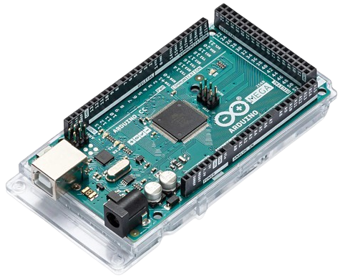
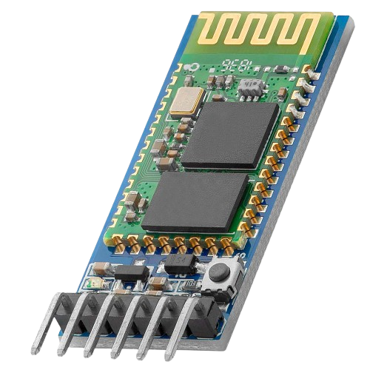
Arduino + HC05

Slide 2
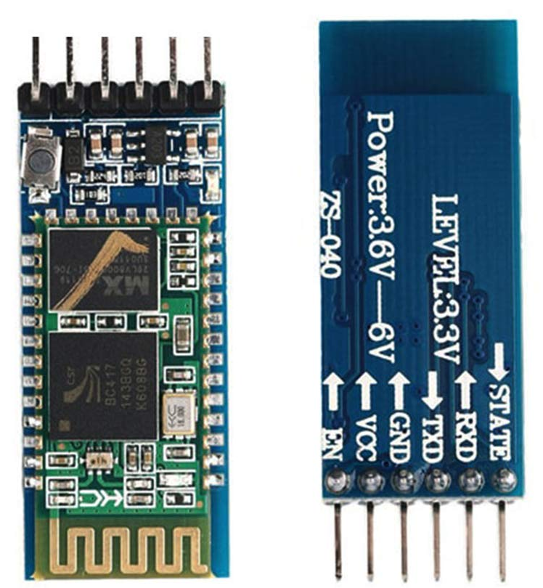
HC05 – Bluetooth Module

Slide 3
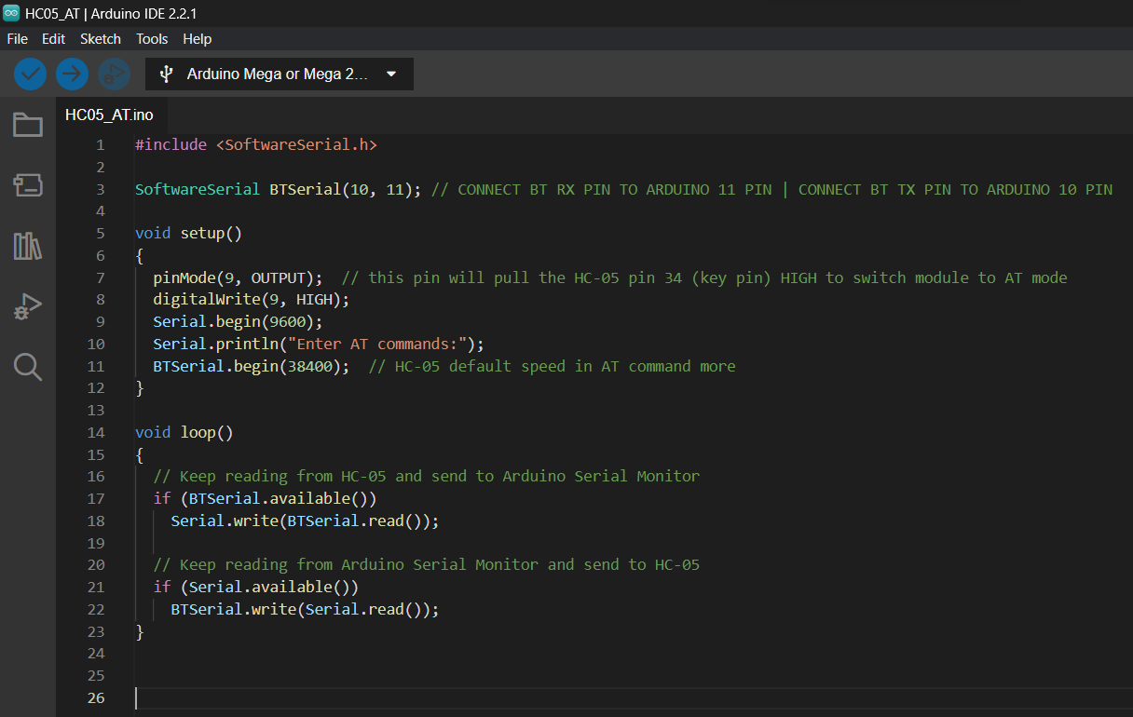
HC05 – Setup Code
Upload code before connecting HC05 module

Slide 4
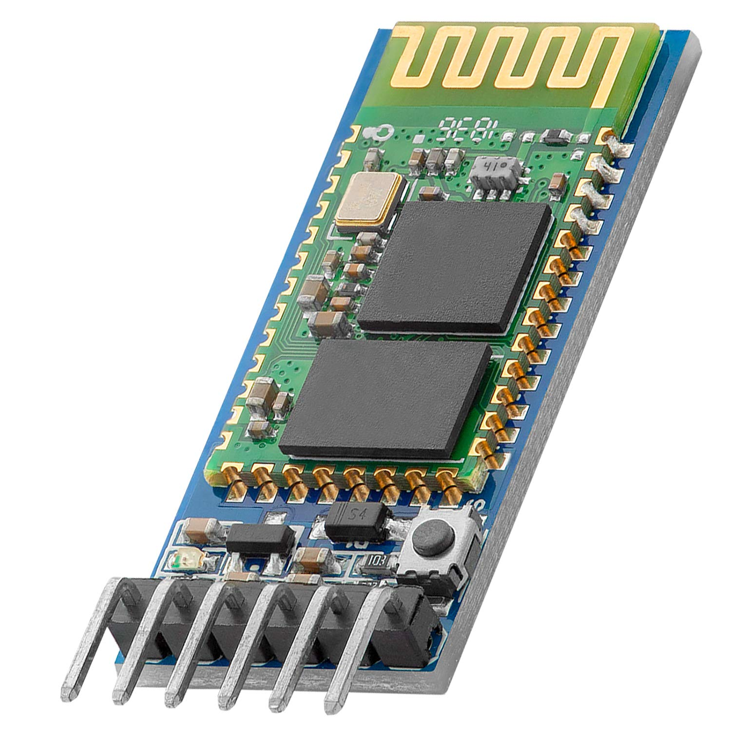
HC05 – Pins and Setup
HC05 | Arduino
RX | PIN 11
TX | PIN 10
GND | GND
VCC | 5V
EN | PIN 9
Hold this button before power until slow blink of LED

Slide 5
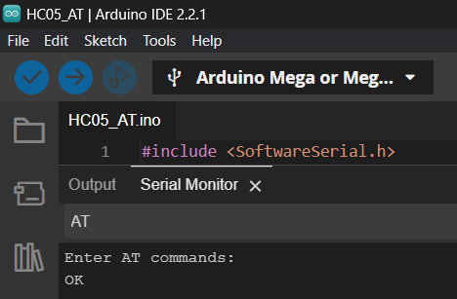
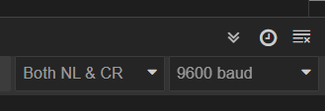
HC05 – AT Commands
Command to check HC05 comm port respond
Must be in same settings
Response confirm proper connection

Slide 6
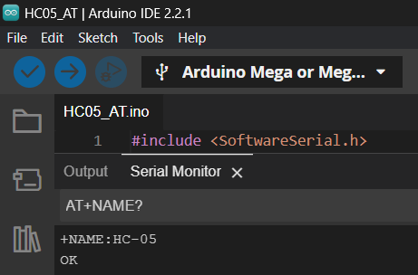
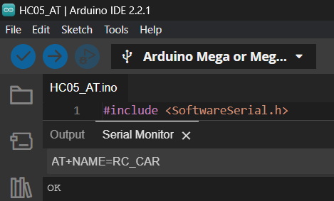
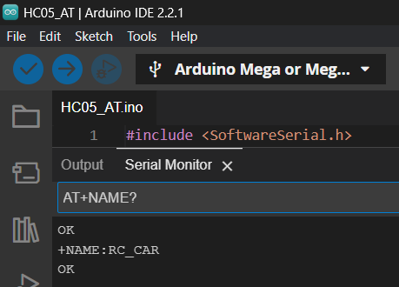
HC05 – AT Commands
Check name
Set new name
Response
Response
Check new name
Response

Slide 7
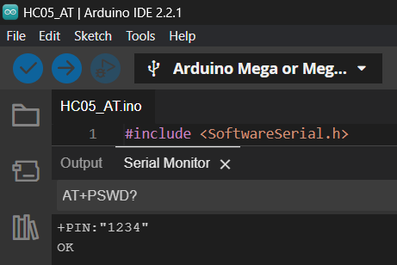
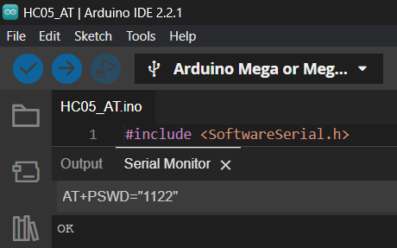
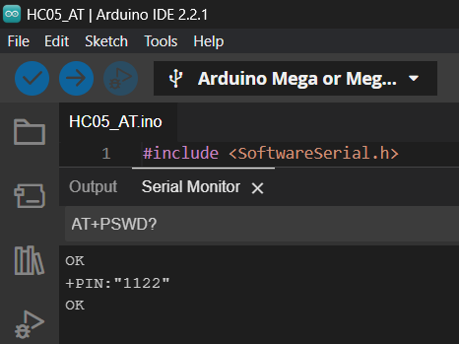
HC05 – AT Commands
Check password
Set new password
Response
Response
Check new password
Response

Slide 8
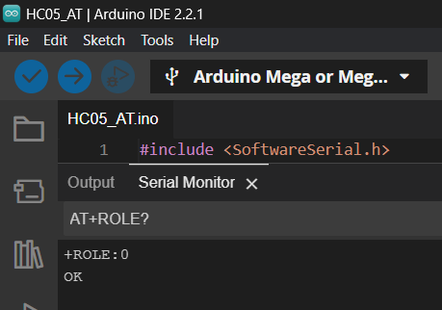
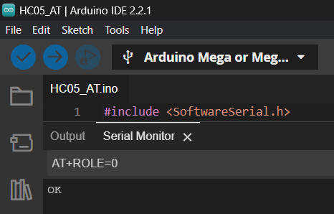
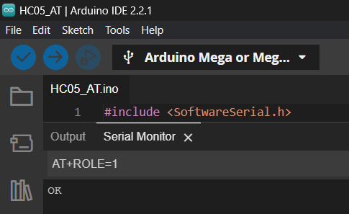
HC05 – AT Commands
Check role
Set role to 0 (Slave)
Response
Response
Required for this activity is 0 (Slave)
Set role to 1 (Master)
Response

Slide 9
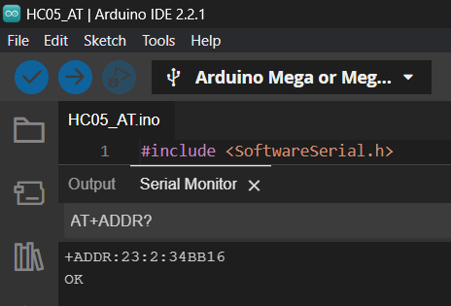
HC05 – AT Commands
Address can be seen on phone upon pairing
Check HC05 module address
Response

Slide 10
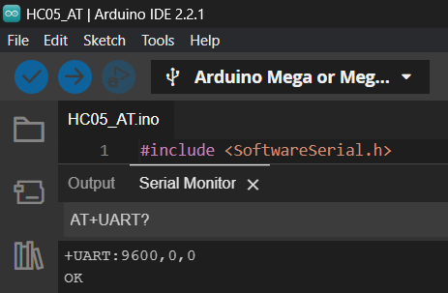
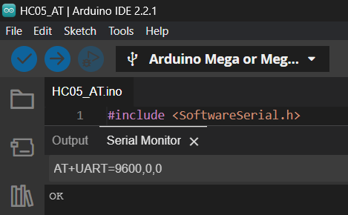
HC05 – AT Commands
This is the required for this activity
Check HC05 module baudrate
Response
Set HC05 module baudrate
Response

Slide 11
HC05 – Pins and Setup
HC05 | Arduino
RX | PIN 11
TX | PIN 10
GND | GND
VCC | 5V

Slide 12
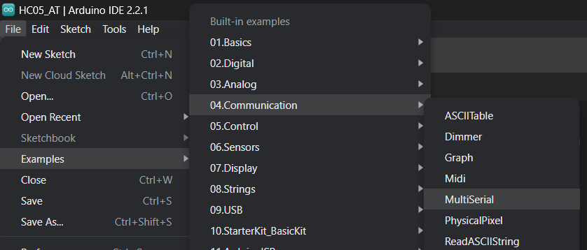
HC05 – Setup Code
Use sample code for function test of HC05 module

Slide 13
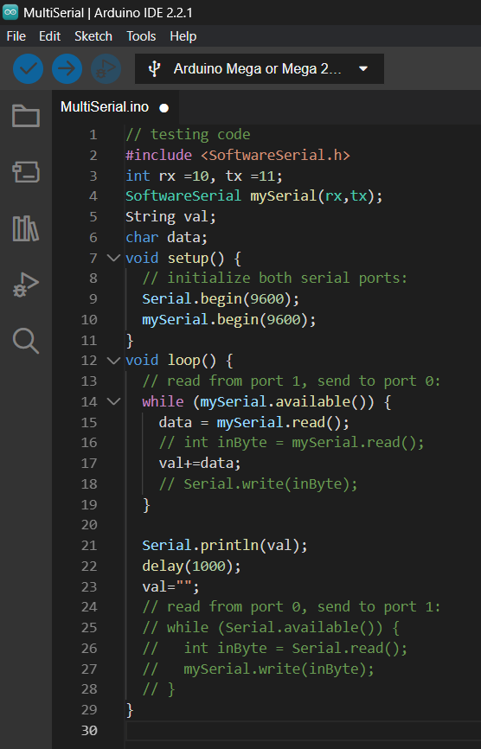
HC05 – Modify code
Upload this modified code to Arduino then connect HC-05 module
HC05 | Arduino
RX | PIN 11
TX | PIN 10
GND | GND
VCC | 5V

Slide 14
Creating android app

Slide 15
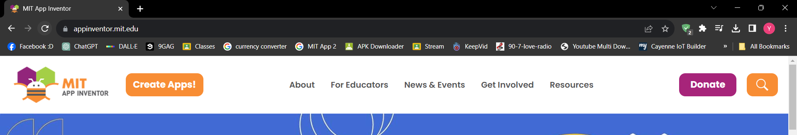
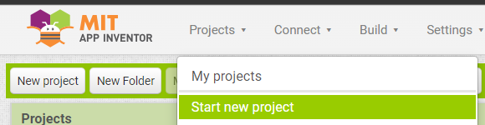
MIT App Inventor
Register using personal e-mail
Project name will appear on your phone upon installation

Slide 16
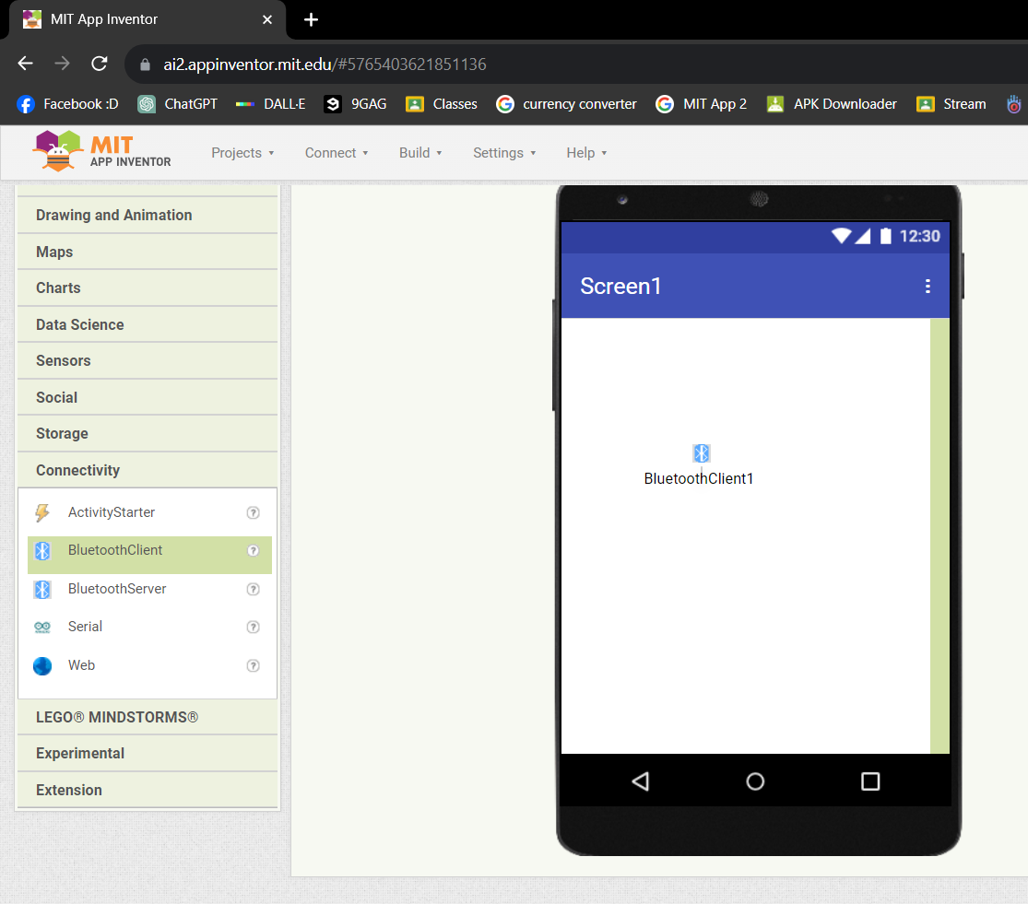
MIT App Inventor
Drag and drop to screen to add object to app

Slide 17
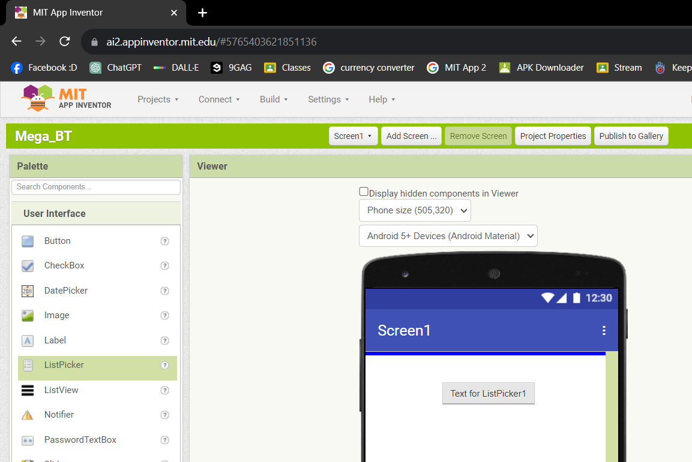
MIT App Inventor
Drag and drop to screen to add object to app

Slide 18
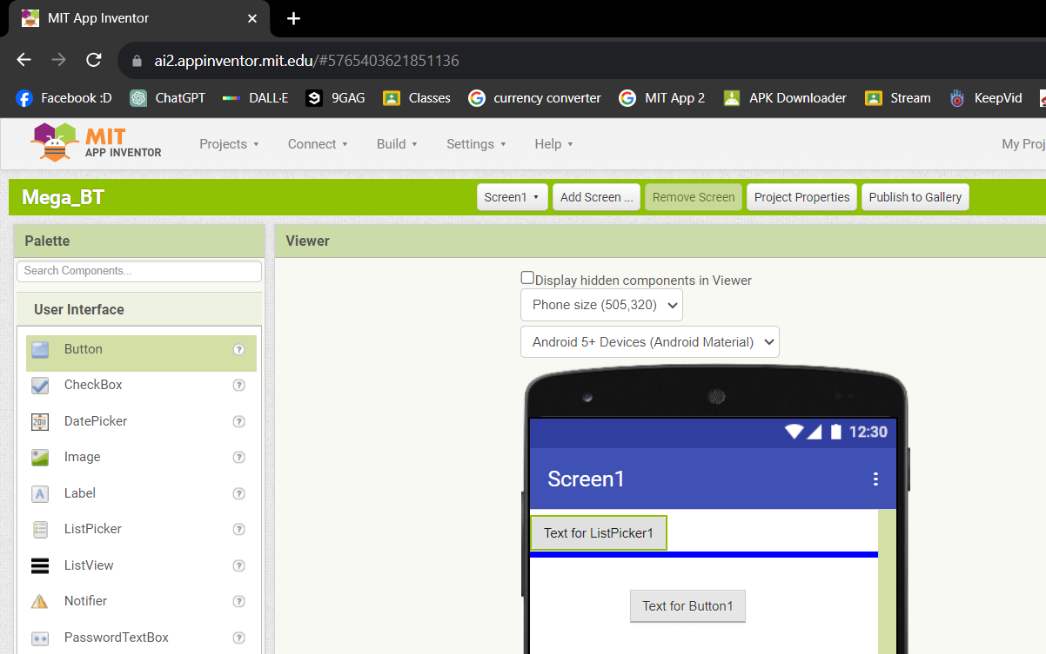
MIT App Inventor
Drag and drop to screen to add object to app

Slide 19
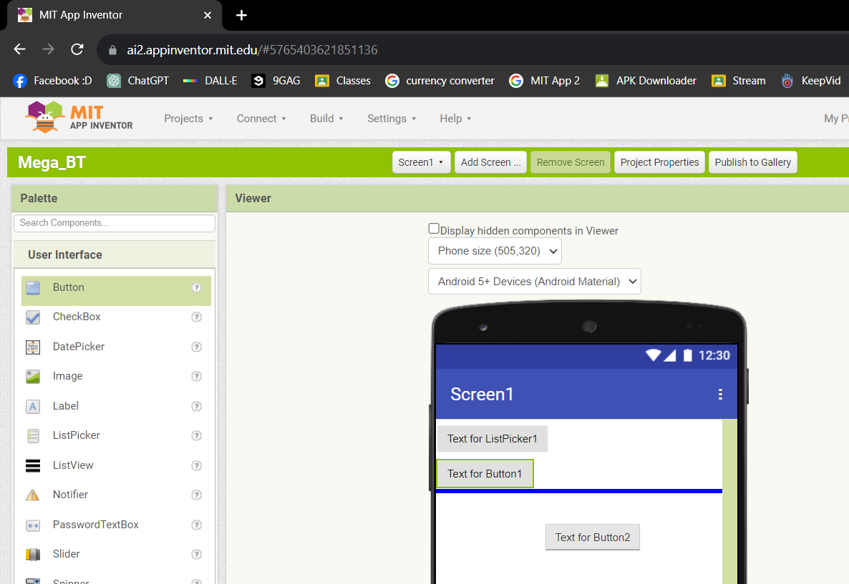
MIT App Inventor
Drag and drop to screen to add object to app

Slide 20
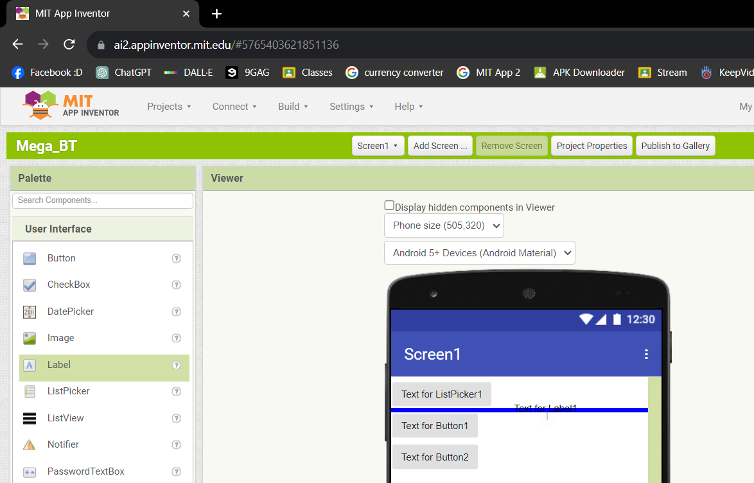
MIT App Inventor
Drag and drop to screen to add object to app

Slide 21
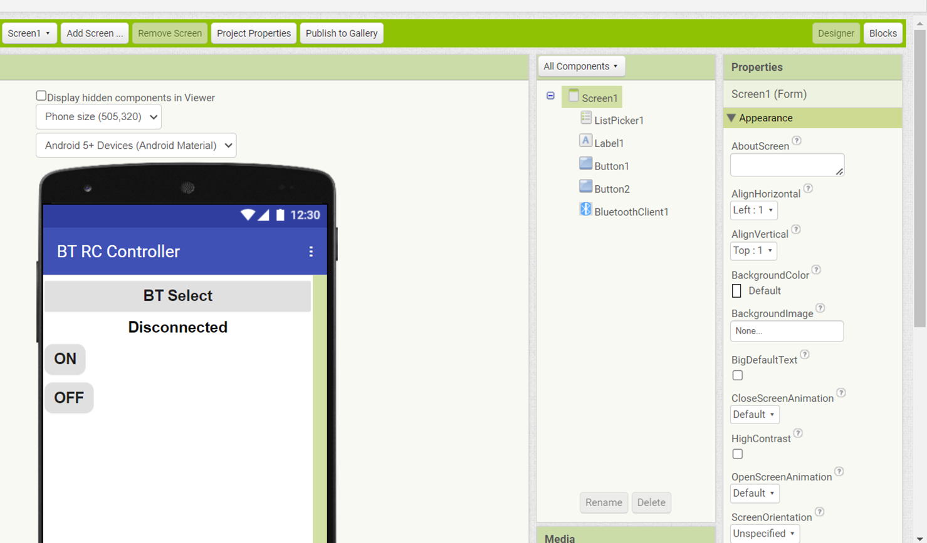
MIT App Inventor
Edit object properties to match sample below

Slide 22
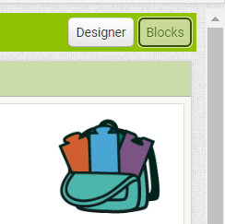
MIT App Inventor
Switch to block to set the app program

Slide 23
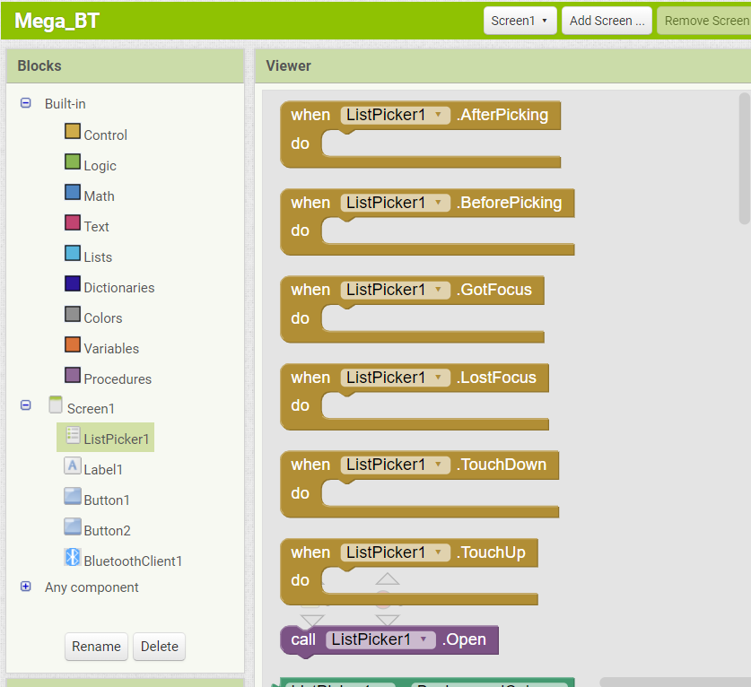
MIT App Inventor
Most code blocks can be found in this section

Slide 24
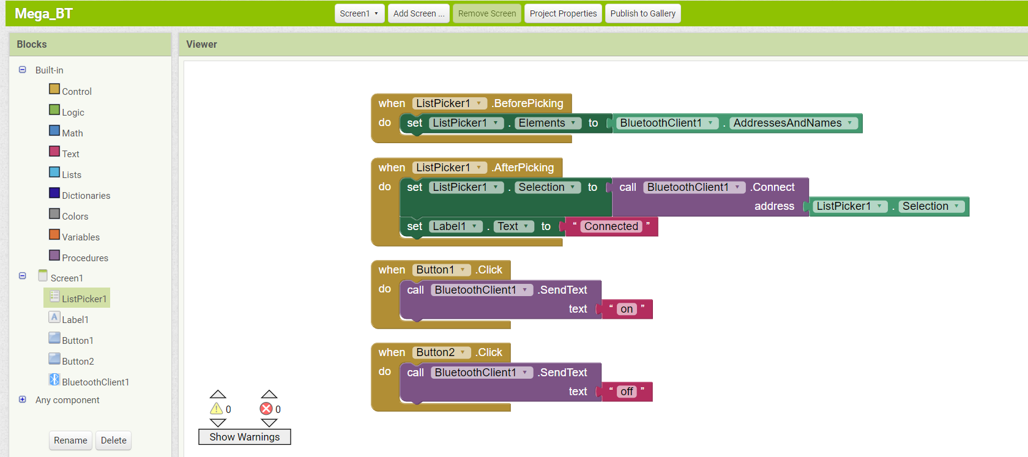
MIT App Inventor
Copy this code blocks for this activity

Slide 25
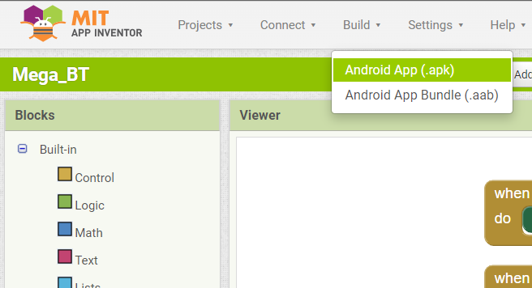
MIT App Inventor
Compile and generate apk installer

Slide 26
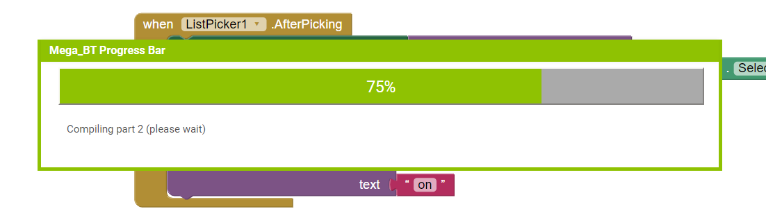
MIT App Inventor
Wait until completion

Slide 27
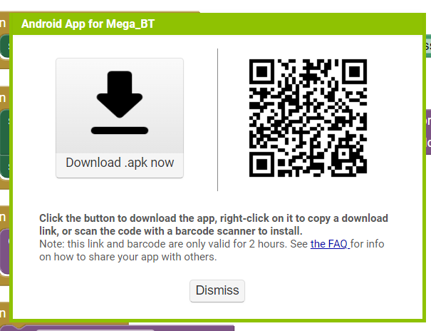
MIT App Inventor
Installer can be manual download or use QR code to install

Slide 28
Phone and Arduino Connection

Slide 29
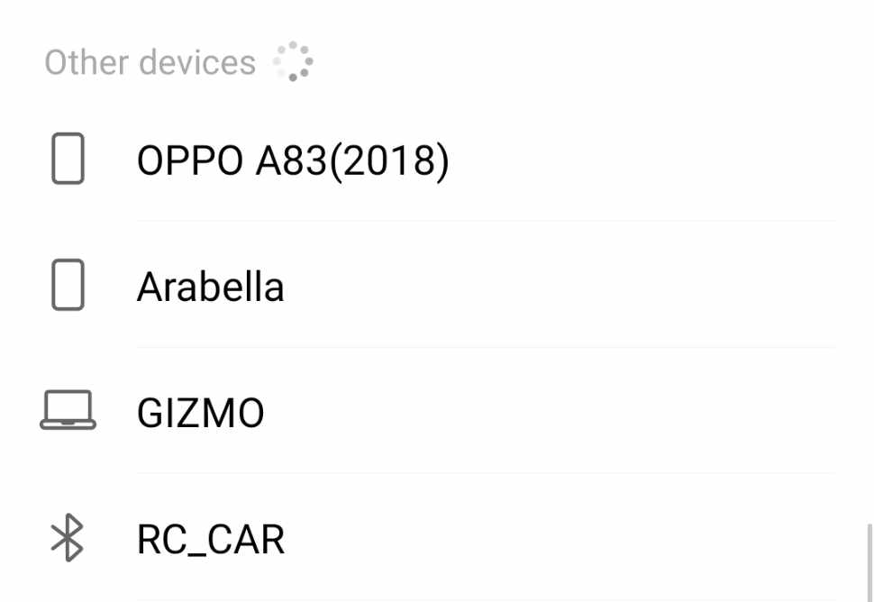
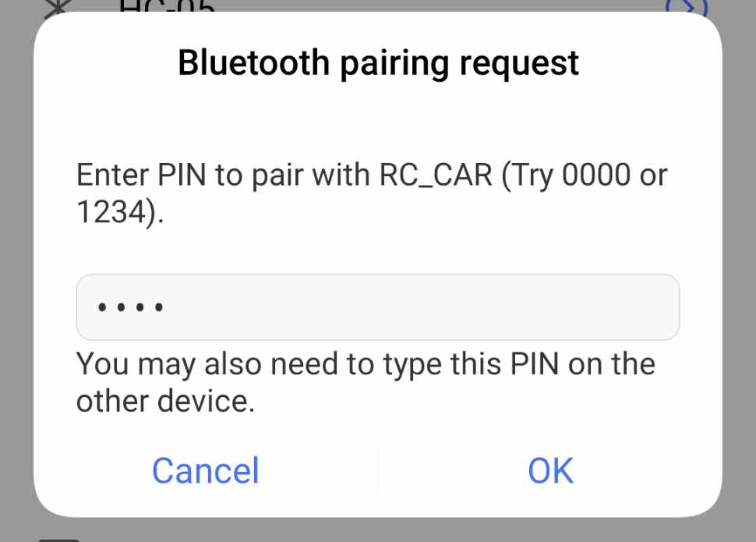
Manual Pairing
Manual pair once to add in paired devices list

Slide 30
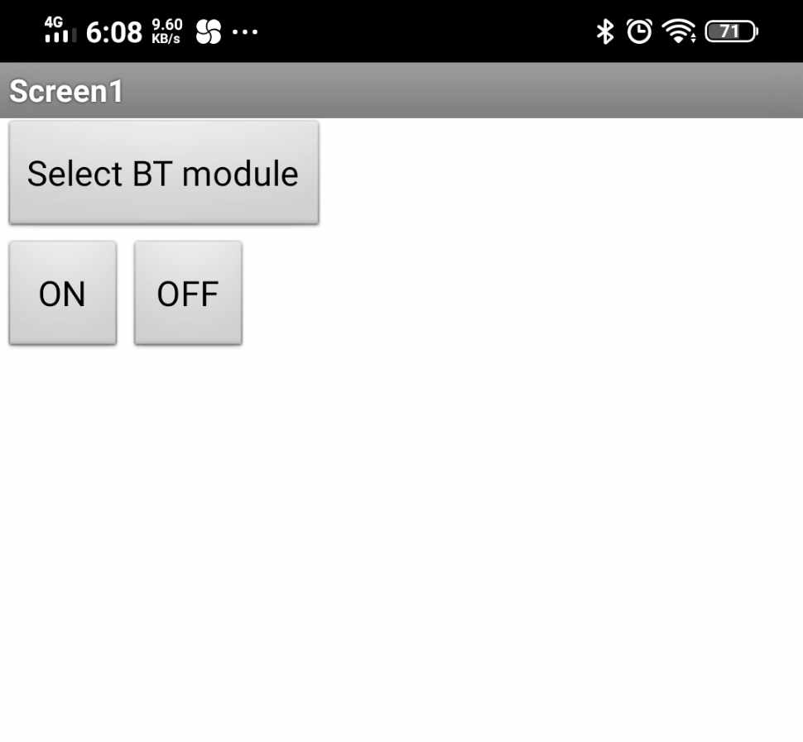
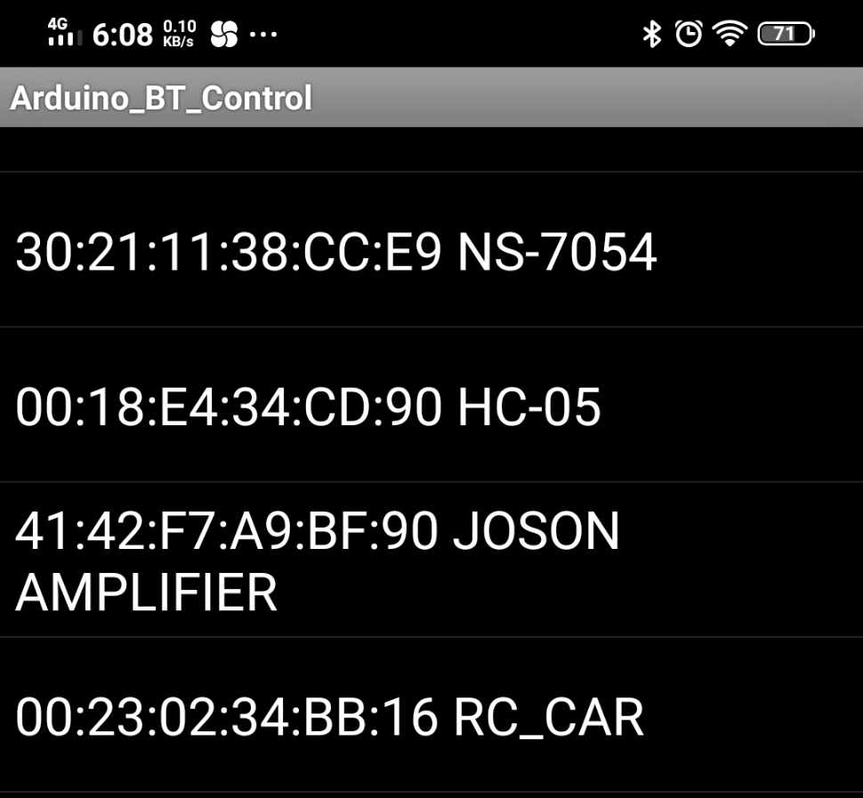
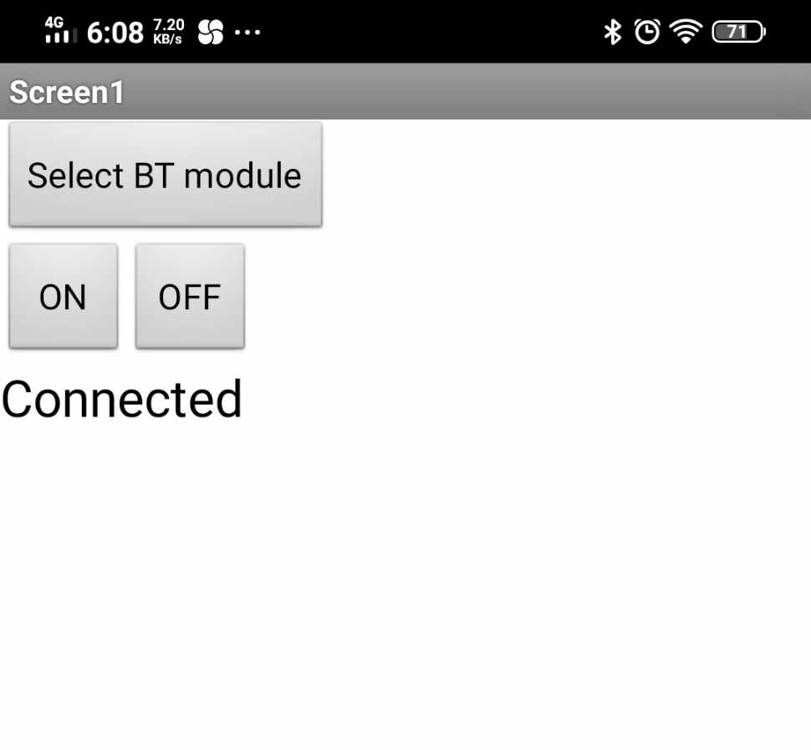
App Pairing
Pair HC05 module using the created app

Slide 31
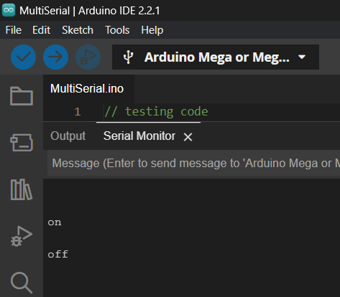
Functionality
Pressing button must have different result as shown below

Slide 32
Finals – Activity 1
Modify the code to control the ON and OFF function of LED using the created android app

